Slide 1
Multiple Regression: A Model for the Mean
Review the notation and concepts of regressioN

Slide 2
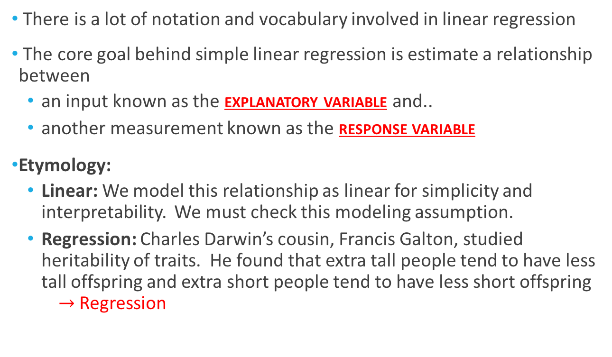
Terminology & Goals
There is a lot of notation and vocabulary involved in linear regression
The core goal behind simple linear regression is estimate a relationship between
an input known as the explanatory variable and..
another measurement known as the response variable
Etymology:
Linear: We model this relationship as linear for simplicity and interpretability. We must check this modeling assumption.
Regression: Charles Darwin’s cousin, Francis Galton, studied heritability of traits. He found that extra tall people tend to have less tall offspring and extra short people tend to have less short offspring $→$ Regression

Slide 3
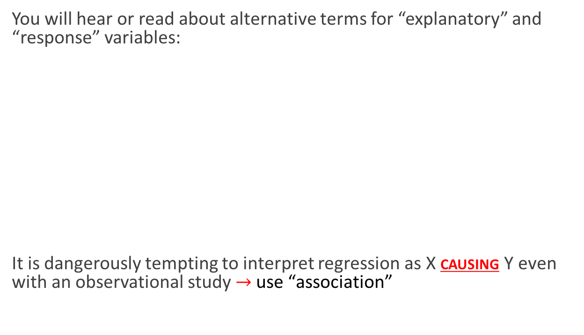
Differing Terminology & Causation
You will hear or read about alternative terms for “explanatory” and “response” variables:
It is dangerously tempting to interpret regression as X causing Y even with an observational study$→$ use “association”
Explanatory:
Independent variable
Exogenous variable
Predictor variable
Covariate
Feature
Input
Response:
Dependent variable
Endogenous variable
Supervisor
Output

Slide 4
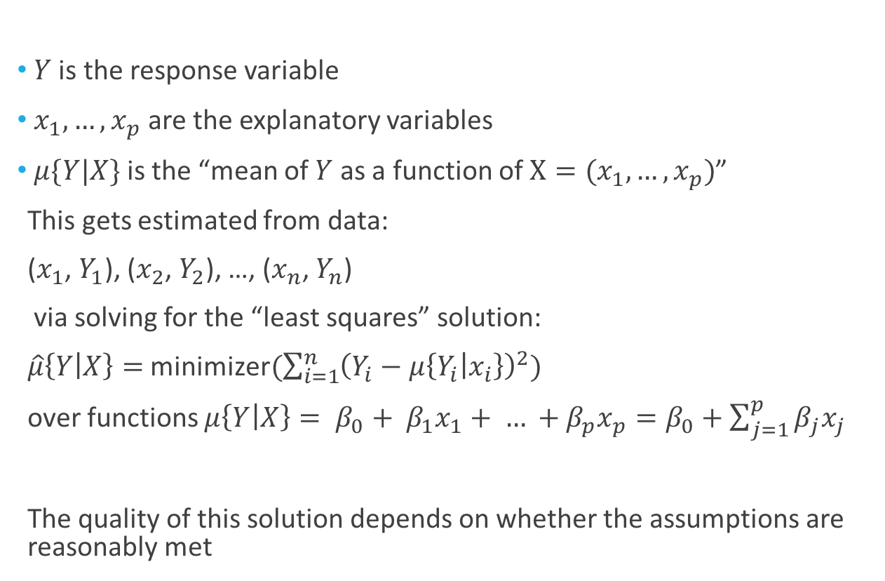
Notation for the Mean
$Y$ is the response variable
$x_{1},…,x_{p}$ are the explanatory variables
$μ\{Y|X\}$ is the “mean of $Y$ as a function of $X=(x_{1},…,x_{p})$”
This gets estimated from data:
($x_{1}$, $Y_{1}$), ($x_{2}$, $Y_{2}$), …, ($x_{n}$, $Y_{n}$)
via solving for the “least squares” solution:
$\hat{μ}\left\{Y | X\right\}=$ minimizer$(\sum_{i=1}^{n}{{\left(Y_{i}−μ\left\{Y_{i} | x_{i}\right\}\right)}^{2}})$
over functions $μ\left\{Y | X\right\}= β_{0}+ β_{1}x_{1}+ … +β_{p}x_{p}=β_{0}+\sum_{j=1}^{p}{β_{j}x_{j}}$
The quality of this solution depends on whether the assumptions are reasonably met

Slide 5
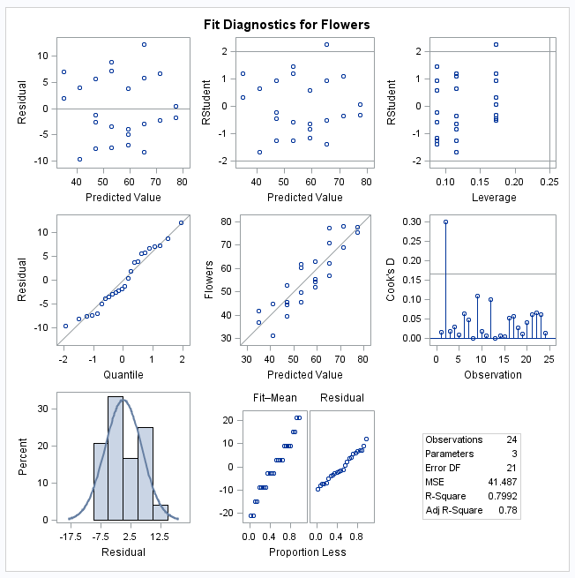
Checking Assumptions
Residuals: No evidence of changing variance nor model misfit
(what does “Predicted Value” mean?)
Influence: No evidence of extreme or influential points
(High leverage + large residual)
Normality: No evidence of any issue
Notes:
Cook’s D: Change in estimate after deleting each observations

Slide 6
Review: Housing Data

Slide 7
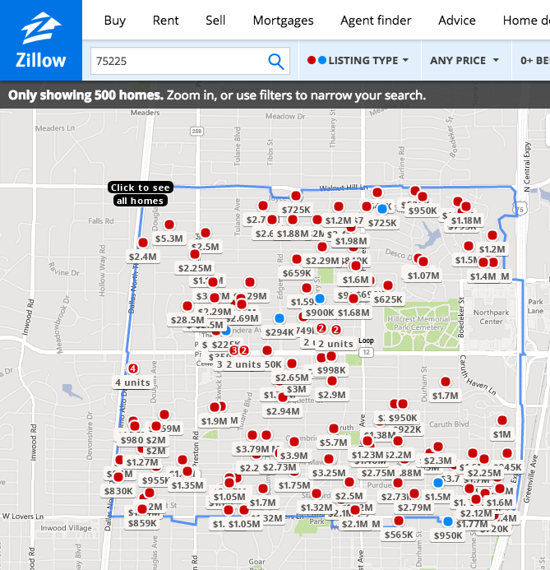
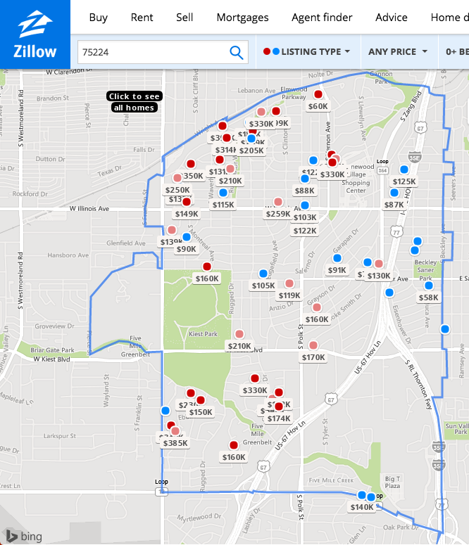
Toward Building a Model for Housing Price

Slide 8
A Scientific Question
It is very important to do statistics from the perspective of a scientist
This means always keeping in mind the scientific question(s) of interest
What are some scientific questions of interest for the housing data?
Perhaps I’m a real estate company that has a few competing house designs:
How many bathrooms should I include?
How many bedrooms?
A few larger houses vs. many smaller houses?
A survey of housing data + multiple regression could be used

Slide 9
Converting a Scientific Question to Statistics
For our survey, key questions:
What is a/the relevant population of interest?
Do we need/want to make causal conclusions?
What is a/the relevant population of interest?
Perhaps the real estate company wants to draw conclusions about houses for sale in a particular area of Dallas during a particular period of time
Then a sample can be drawn with this population in mind
Do we need/want to make causal conclusions?
In this case, an experiment establishing a causal relationship would be very hard to do (why?)
Hence, we will be forced to argue informally about possible confounders

Slide 10
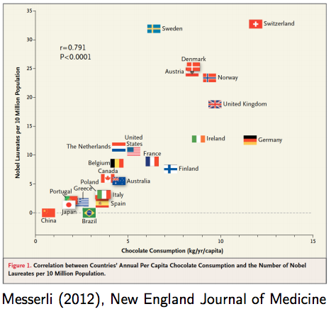
Chocolate Study
Important:
- We can say that chocolate consumption is predictive of Nobel prizes
- We cannot say that changing chocolate consumption will change the number of Nobel prizes
A major reason for this distinction is the possibility of confounding variables

Slide 11
Chocolate Study
Important:
Prediction: Predict Y after observing X
Causation: Predict Y after setting X
(note that randomization breaks any confounding relationships and hence allows for causal inference)

Slide 12


Slide 13
Converting a Scientific Question to Statistics
Let’s consider: How many bathrooms should I include?
We want to estimate a relationship between bathrooms and sales price
We know that we cannot formally control for confounders via sampling
Even if sales price is larger if a house has an extra bathroom, is it due to:
the house being larger,
the house having more bedrooms (since baths and bedrooms are correlated)
the house being in a better neighborhood
….
We can informally control for confounders by estimating a relationship that “fixes” the levels of some (but not all) of these confounders

Slide 14
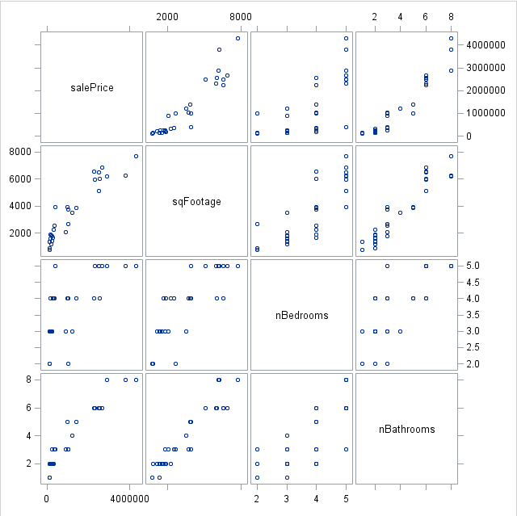
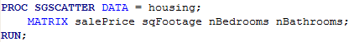
Scatterplot Matrix
“Scatterplot matrix”
Or
“Draftsmen plot”
Or
“Pairs plot”

Slide 15
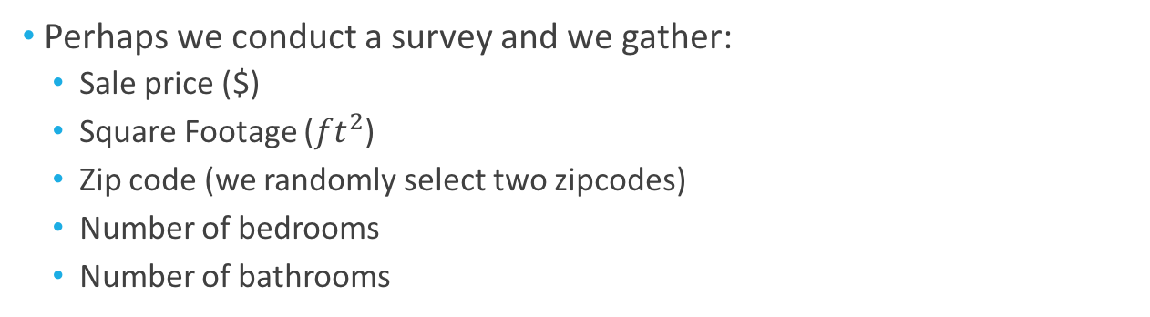
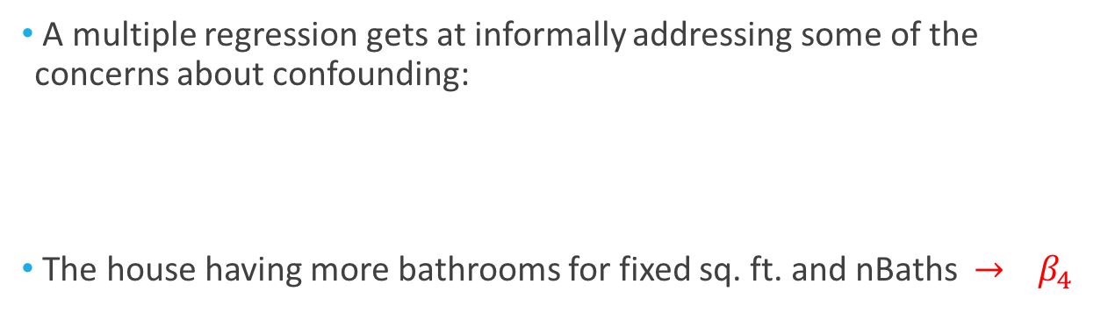
Converting a Scientific Question to Statistics
Perhaps we conduct a survey and we gather:
Sale price ($)
Square Footage (${ft}^{2}$)
Zip code (we randomly select two zipcodes)
Number of bedrooms
Number of bathrooms
A multiple regression gets at informally addressing some of the concerns about confounding:
The house having more bathrooms for fixed sq. ft. and nBaths $→$ $β_{4}$
$$μ\left\{salePrice | {ft}^{2}, zipcode, nBedrooms, nBaths\right\}=β_{0}+{β_{1}ft}^{2}+β_{2}zipcode+β_{3}nBedrooms+β_{4}nBaths$$

Slide 16
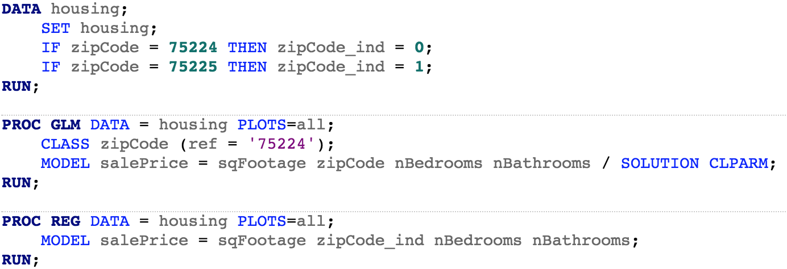
Specifying a Multiple Regression in SAS
We can two this in at least two ways:
(We will use this output unless otherwise indicated)
$$μ\left\{salePrice | {ft}^{2}, zipcode, nBedrooms, nBaths\right\}=β_{0}+{β_{1}ft}^{2}+β_{2}zipcode+β_{3}nBedrooms+β_{4}nBaths$$

Slide 17
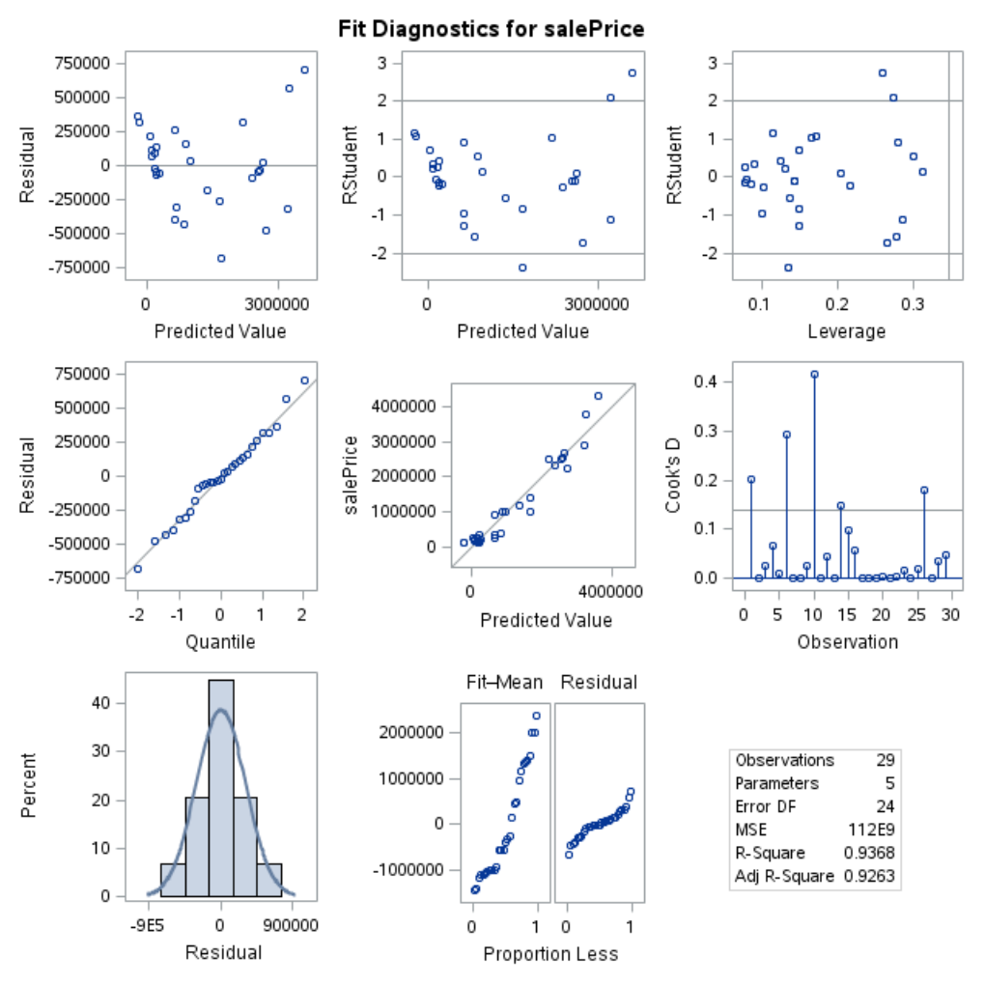
Checking Assumptions
Only concern: moderate indication of a ”smiley face” in the residuals
(we will return to this in a bit)
There is one assumption not included on this plot..

Slide 18
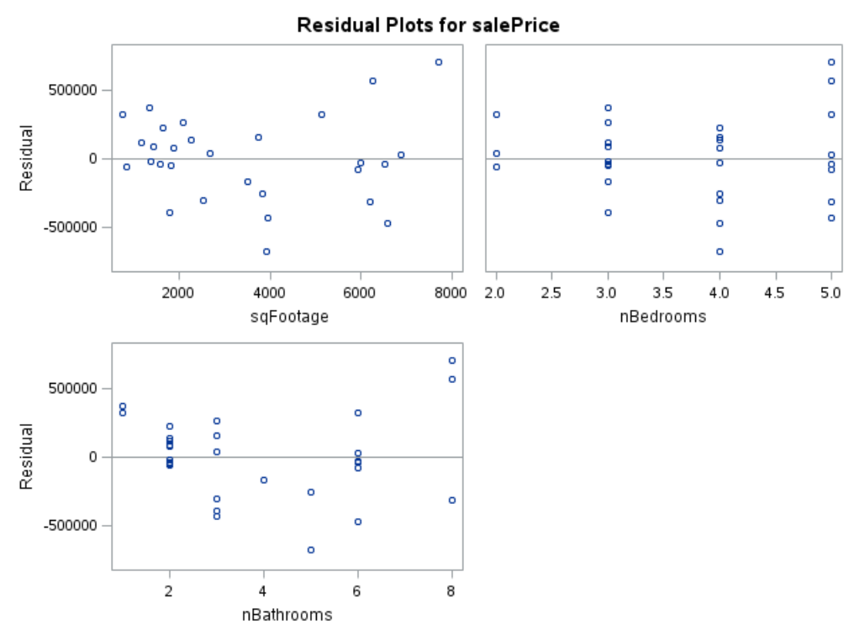
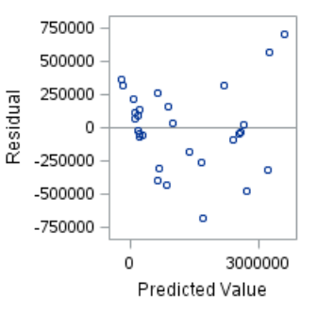
Assumption: Independence
Independence gets checked in three ways:
Do residuals appear to be related to an explanatory variable?
Do residuals appear to be related to each other
3. Is there any reason to suspect that observations might be dependent?
Example: Houses are spatially correlated
(we are including zipcode)
Implication of independence violation: Underestimate variability (e.g. p-values too small)

Slide 19
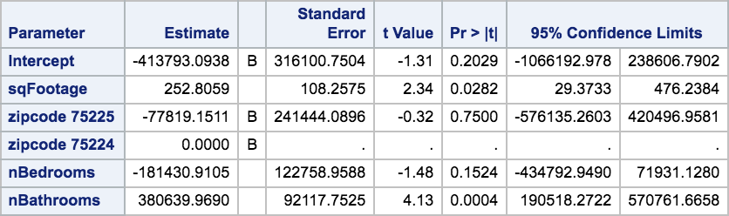
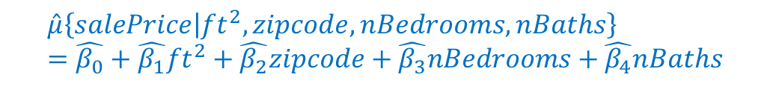
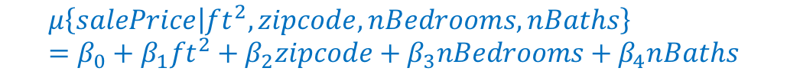
Converting a Scientific Question to Statistics
Suppose we are satisfied that the assumptions are satisfactorily met
We have an estimate of the model:
What we do from here depends a lot on the scientific question at hand
$$μ\left\{salePrice | {ft}^{2}, zipcode, nBedrooms, nBaths\right\}=β_{0}+{β_{1}ft}^{2}+β_{2}zipcode+β_{3}nBedrooms+β_{4}nBaths$$
(Once the model is estimated, the parameters are written with a “hat” to indicate functions of the data)
$$\hat{μ}\left\{salePrice | {ft}^{2}, zipcode, nBedrooms, nBaths\right\}=\hat{β_{0}}+{\hat{β_{1}}ft}^{2}+\hat{β_{2}}zipcode+\hat{β_{3}}nBedrooms+\hat{β_{4}}nBaths$$
(See pages 276-278 for a discussion on this output)

Slide 20
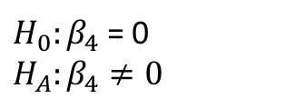
Converting a Scientific Question to Statistics
(A one-sided test is perhaps more appropriate for this question)
Our question: How many bathrooms should I include?
Preliminary question: Does number of bathrooms seem to be related to sales price given the other terms in the model?
“There is evidence that the number of bathrooms is associated with mean sales price given the other terms in the model. A range of plausible values are a difference in mean sales price between $190518 to $570561 for houses with the same sq. ft, # of bedrooms, and zipcode but 1 bathroom difference.”
(See pages 244-246 & 278-289 in book for an discussion on interpreting regression output)
$H_{0}:β_{4}$ = 0
$H_{A}:β_{4}≠0$

Slide 21
Converting a Scientific Question to Statistics
Now for a more nuanced question: Should we keep all the terms in the model?
The answer to this question depends on our goal and the types of errors we are willing to make

Slide 22
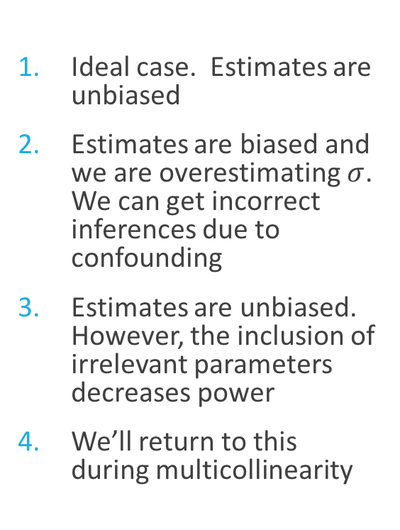
Multiple Regression and “Wrong” Explanatory Variables
There are roughly four possible (unknown) outcomes:
Model is correctly specified. All relevant explanatory variables are included
Model is under specified. Some important explanatory variables are omitted
Model includes unimportant explanatory variables
Model is over specified. Some redundant (or nearly redundant) explanatory variables are included
Ideal case. Estimates are unbiased
Estimates are biased and we are overestimating $σ$. We can get incorrect inferences due to confounding
Estimates are unbiased. However, the inclusion of irrelevant parameters decreases power
We’ll return to this during multicollinearity

Slide 23
Converting a Scientific Question to Statistics
So, should be keep all the terms in the model?
Going by the four considerations from the previous slides, I would leave all the explanatory variables in the model as:
I am concerned about confounding as my scientific question of interest is directly about inference (as opposed to prediction)
It is more conservative to leave them in there (the degrees of freedom for the t-test is smaller)

Slide 24
Housing Data: Revisiting the Regression Fit

Slide 25
Re-Checking Assumptions
Only concern: moderate indication of a ”smiley face” in the residuals
(we will return to this in a bit)
Let’s see if we can address this pattern in the residuals
First, let’s look at a plot of the fitted values vs. nBathrooms

Slide 26
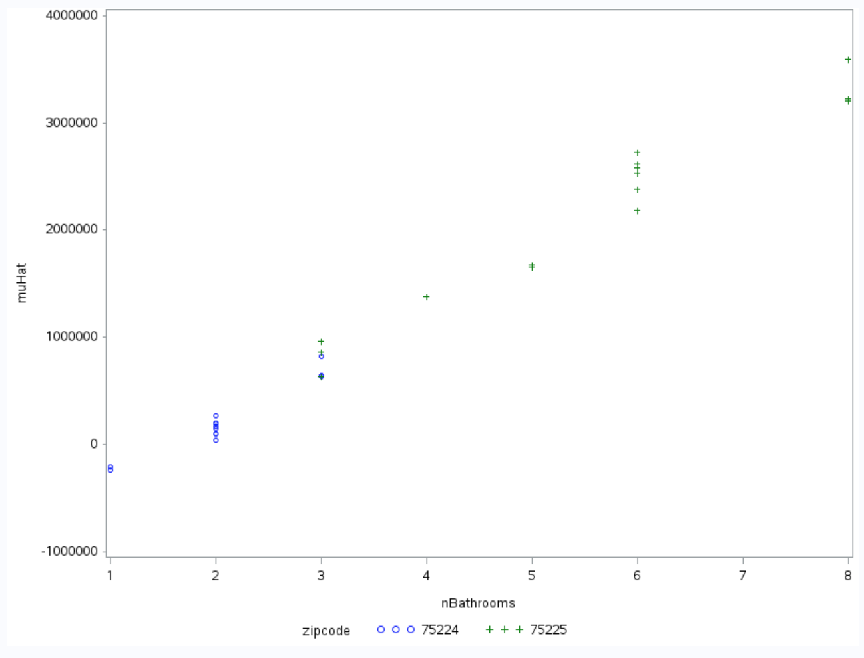
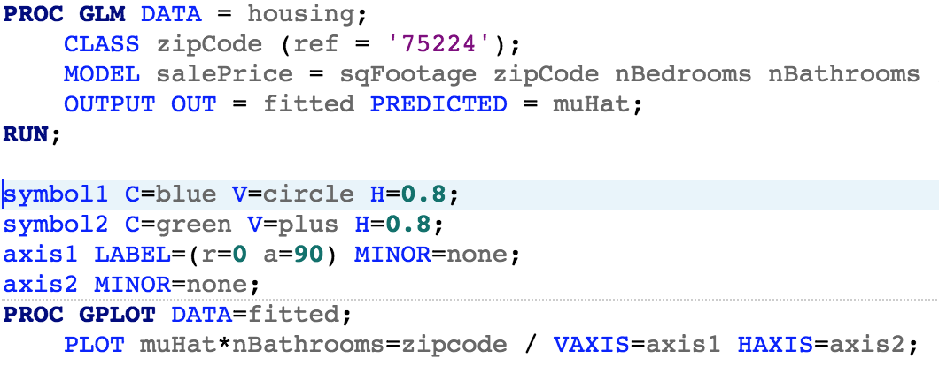
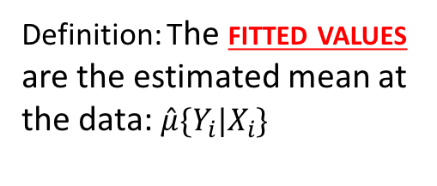
Fitted Values vs. nBathrooms
Definition: The fitted values are the estimated mean at the data: $\hat{μ}\{Y_{i}|X_{i}$}
These negative fitted values are concerning

Slide 27
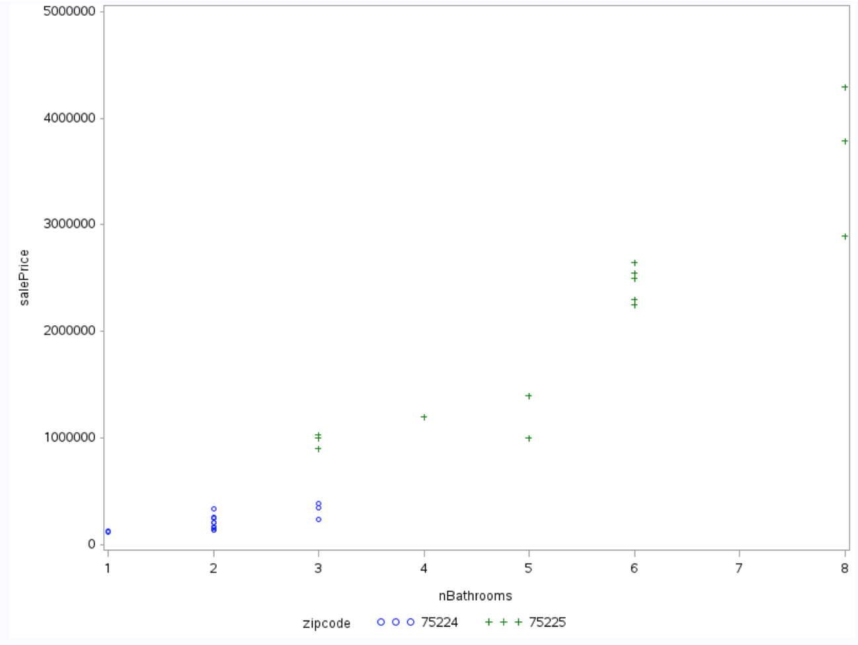
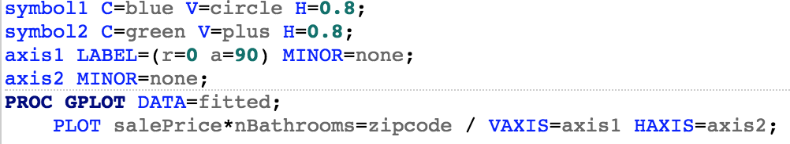
Sales Price vs. nBathrooms
There is a some indication here that a different slope is required for the different zipcodes

Slide 28
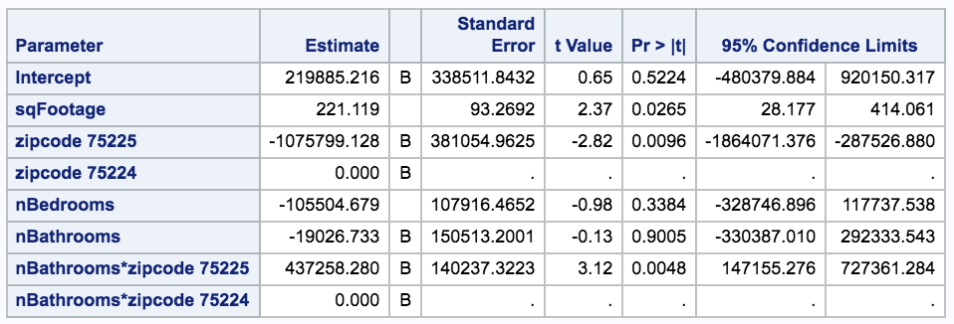
Adding an interaction term
Evidence for a nonzero interaction term. Reminder: Only look at p-value for interaction, not for main effects.

Slide 29
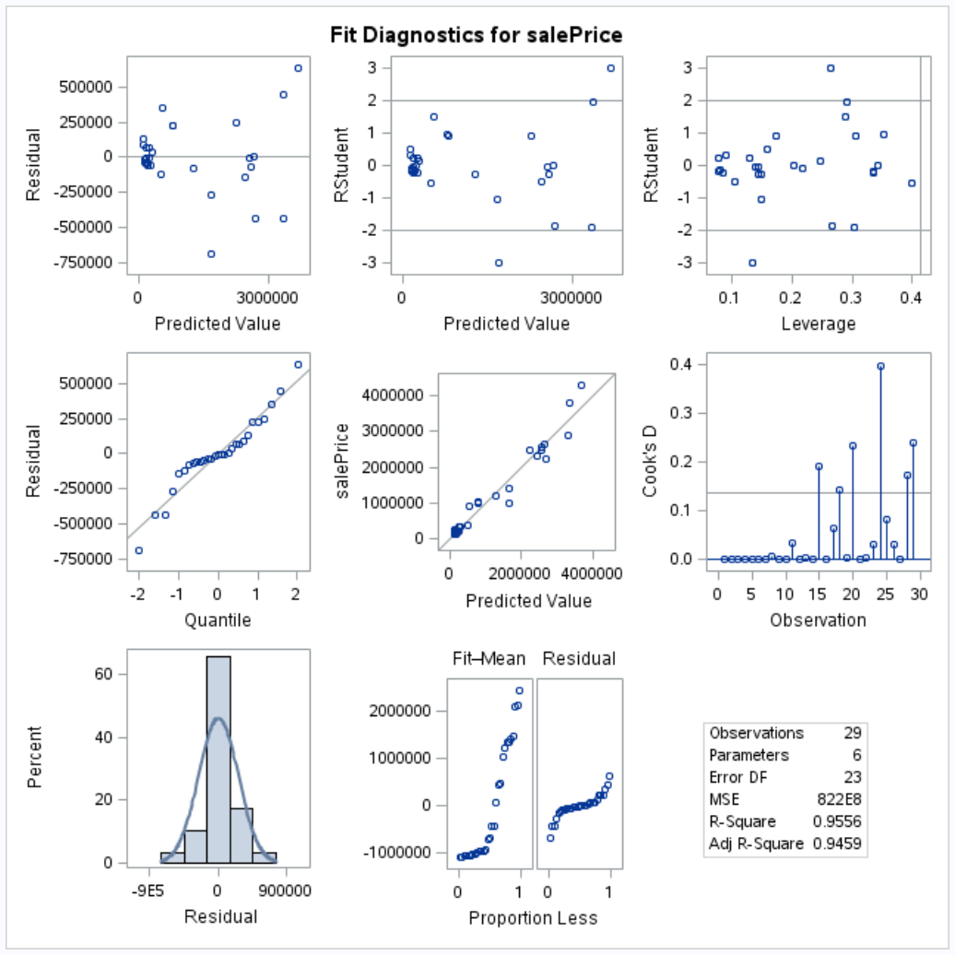
Adding an interaction term
There is moderate evidence of a lack of model fit
There is both a pattern in the residuals and evidence of increasing variance
In this case, a log transform can sometimes help

Slide 30
Analysis Detour: Inference with Interactions

Slide 31
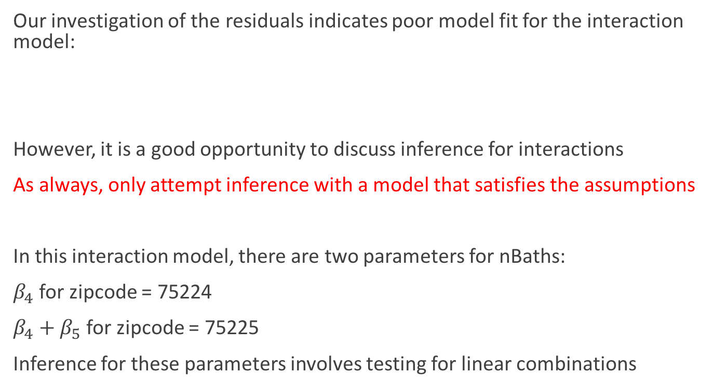
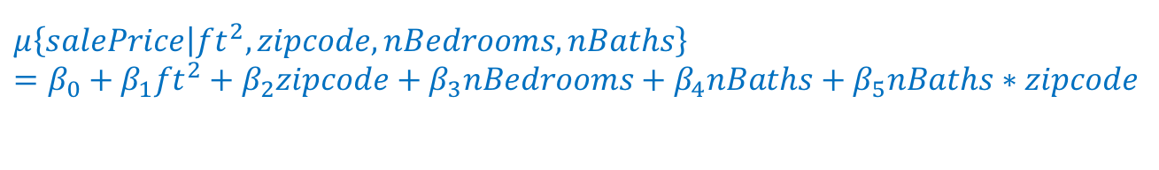
Inference for Interactions
Our investigation of the residuals indicates poor model fit for the interaction model:
However, it is a good opportunity to discuss inference for interactions
As always, only attempt inference with a model that satisfies the assumptions
In this interaction model, there are two parameters for nBaths:
$β_{4}$ for zipcode = 75224
$β_{4}+β_{5}$ for zipcode = 75225
Inference for these parameters involves testing for linear combinations
$$μ\left\{salePrice | {ft}^{2}, zipcode, nBedrooms, nBaths\right\}$$
$=β_{0}+{β_{1}ft}^{2}+β_{2}zipcode+β_{3}nBedrooms+β_{4}nBaths$ $+{ β}_{5}nBaths∗zipcode$

Slide 32
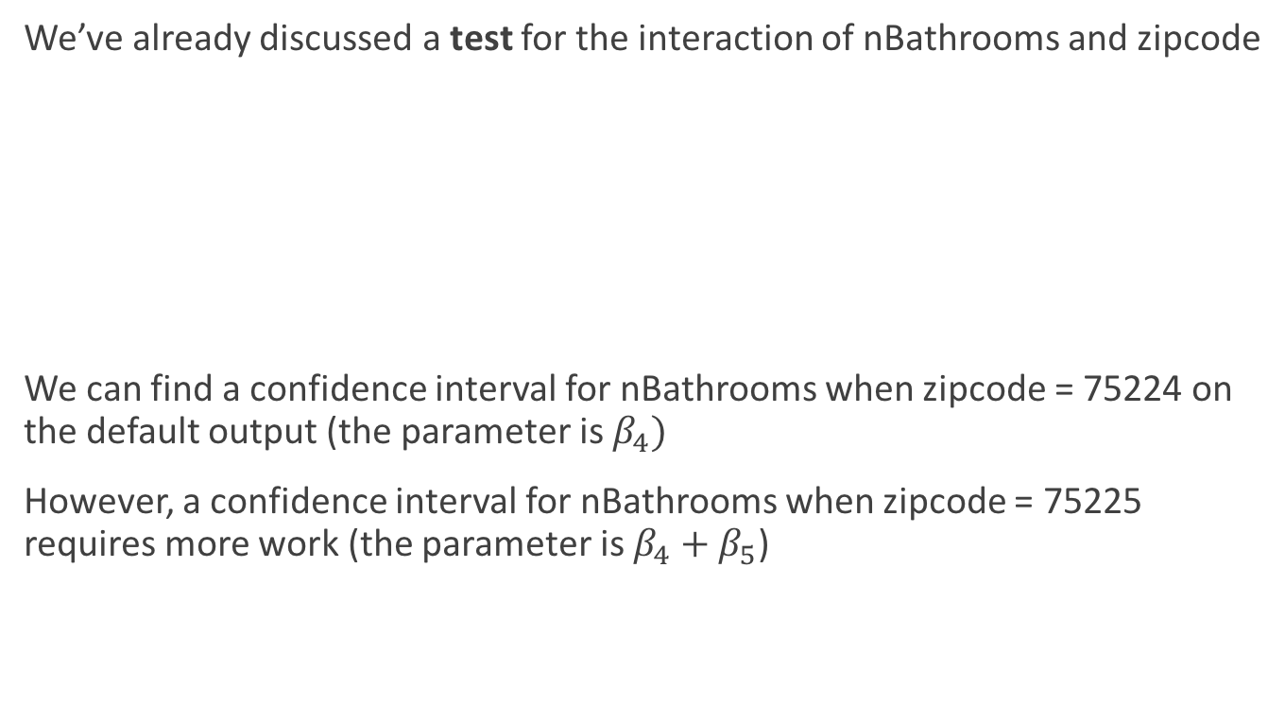
Inference for Interactions
We’ve already discussed a test for the interaction of nBathrooms and zipcode
We can find a confidence interval for nBathrooms when zipcode = 75224 on the default output (the parameter is $β_{4})$
However, a confidence interval for nBathrooms when zipcode = 75225 requires more work (the parameter is $β_{4}+β_{5}$)
When the categorical variable has more than two levels, we need to do an “extra sums of squares F test”
(Chapter 10.3.2 in book and the next set of lecture notes)

Slide 33
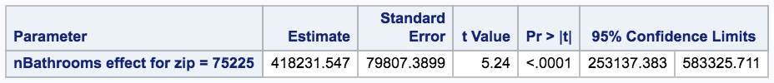
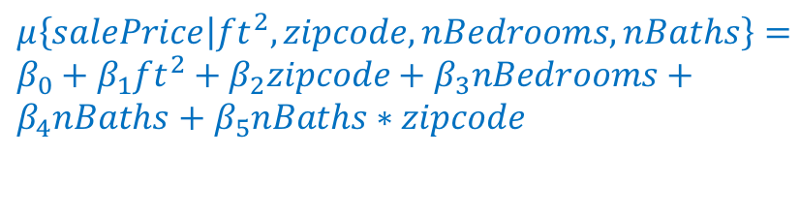
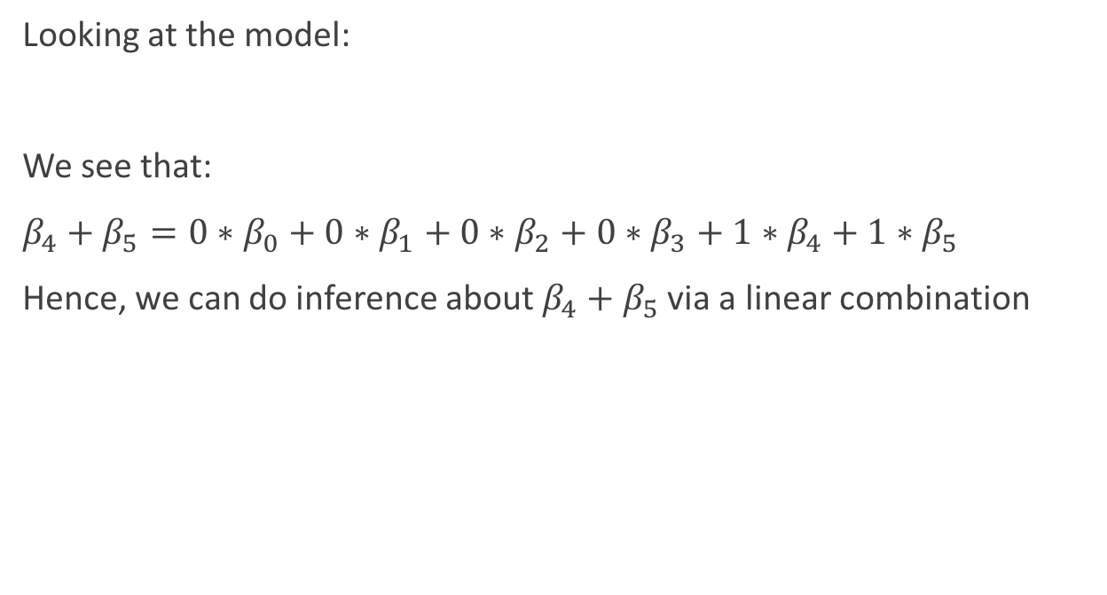
Inference for Interactions: Linear Combinations
Looking at the model:
We see that:
$β_{4}+β_{5}=0∗β_{0}+0∗β_{1}+0∗β_{2}+0∗β_{3}+1∗β_{4}+1∗β_{5}$
Hence, we can do inference about $β_{4}+β_{5}$ via a linear combination
$μ\left\{salePrice | {ft}^{2}, zipcode, nBedrooms, nBaths\right\}=β_{0}+{β_{1}ft}^{2}+β_{2}zipcode+β_{3}nBedrooms+β_{4}nBaths$ $+{ β}_{5}nBaths∗zipcode$

Slide 34
Return to Regular Analysis: Transformed Response

Slide 35
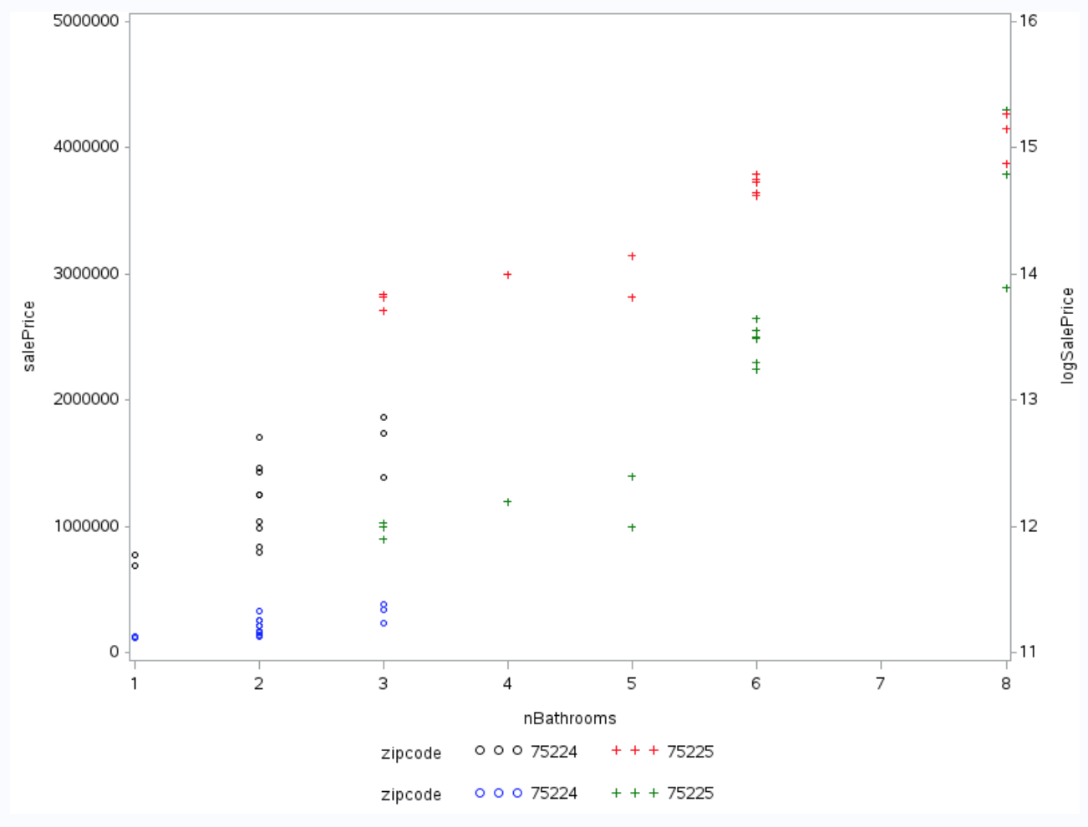
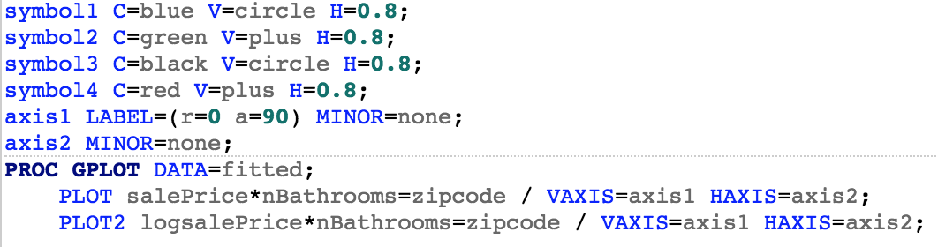
Considering a Log Transformation
Small values tend to ”spread out”
Larger values tend to “compress together”

Slide 36
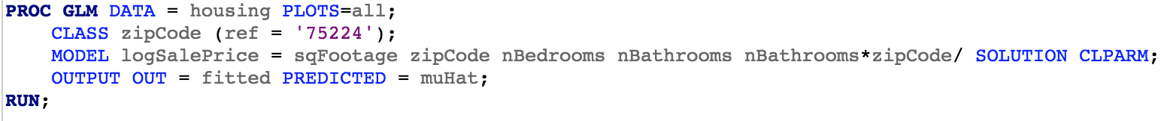
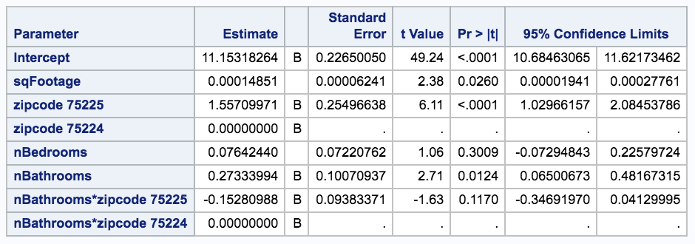
Using a Transformed Response
No evidence for a nonzero interaction term. We should consider a simpler model without an interaction

Slide 37
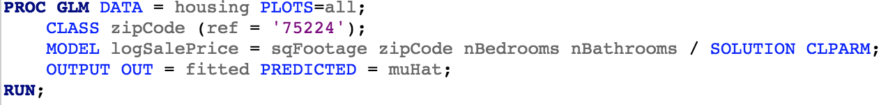
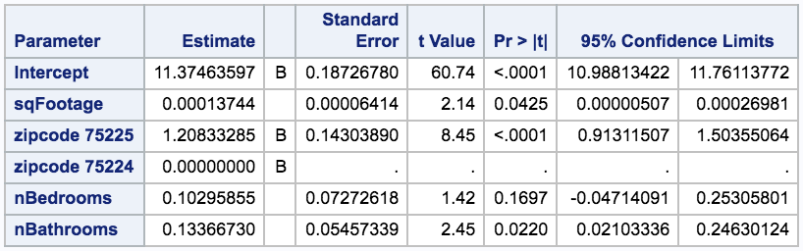
Using a Transformed Response: Remove Interaction

Slide 38
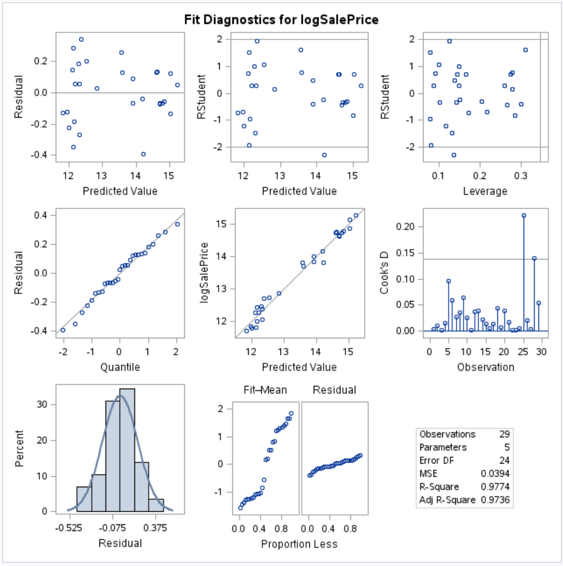
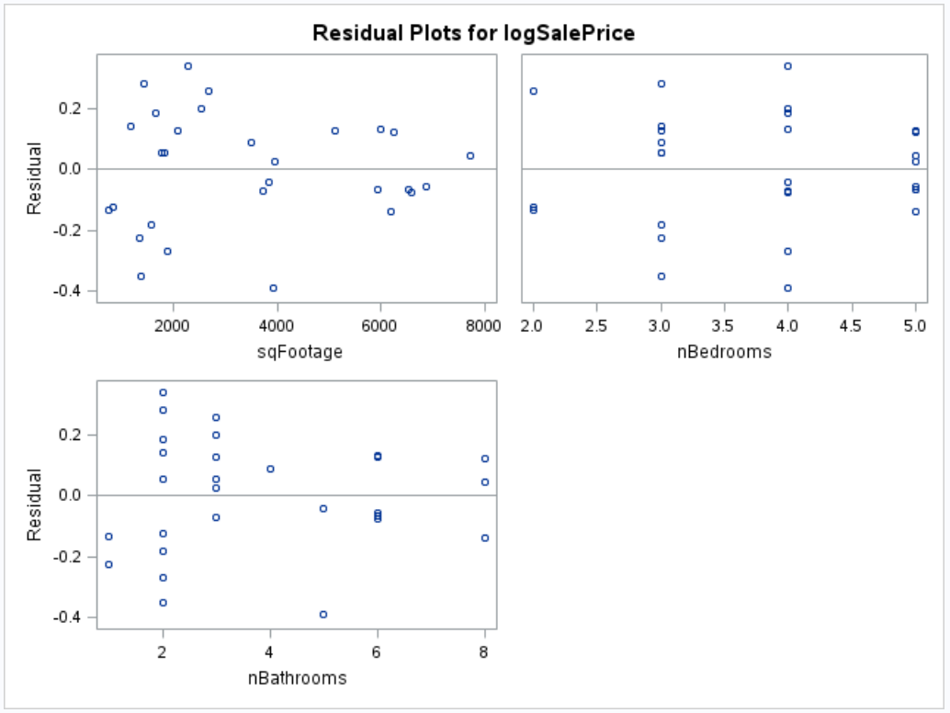
Re-Checking the Assumptions

Slide 39
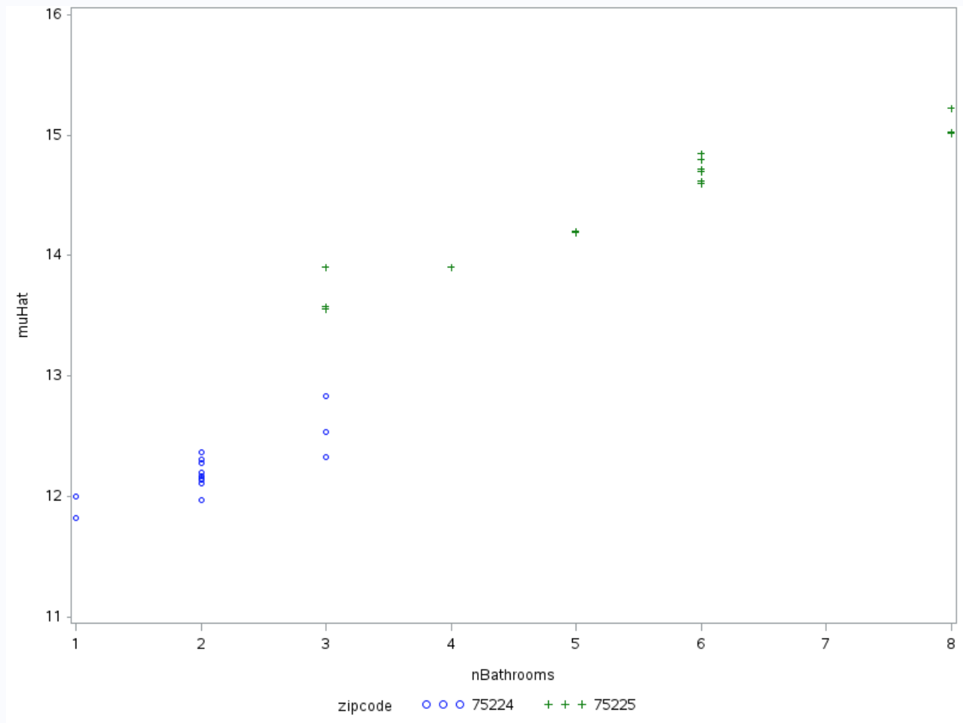
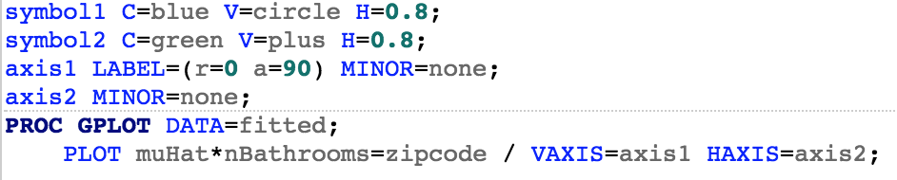
One Last Look at Fitted Values

Slide 40
Interpreting the Model
“There is evidence that the number of bathrooms is associated with median sales price given the other terms in the model. A range of plausible values is a multiplicative change in median sales price between 1.02 and 1.28 for houses with the same sq. ft, # of bedrooms, and zipcode but 1 bathroom difference.”
(See pages 250-251 in book for an interpretation discussion)

Slide 41
Correlation and R-Square

Slide 42
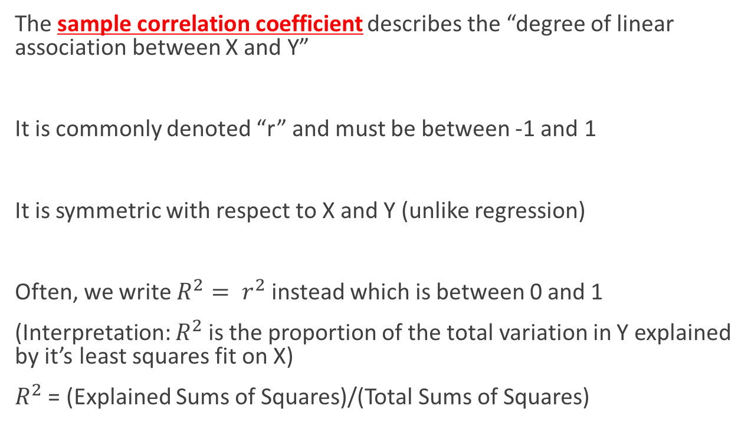
Correlation and R-Square
The sample correlation coefficient describes the “degree of linear association between X and Y”
It is commonly denoted “r” and must be between -1 and 1
It is symmetric with respect to X and Y (unlike regression)
Often, we write $R^{2}= r^{2}$ instead which is between 0 and 1
(Interpretation: $R^{2}$ is the proportion of the total variation in Y explained by it’s least squares fit on X)
$R^{2}$ = (Explained Sums of Squares)/(Total Sums of Squares)

Slide 43
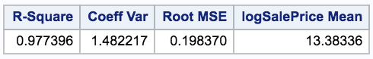
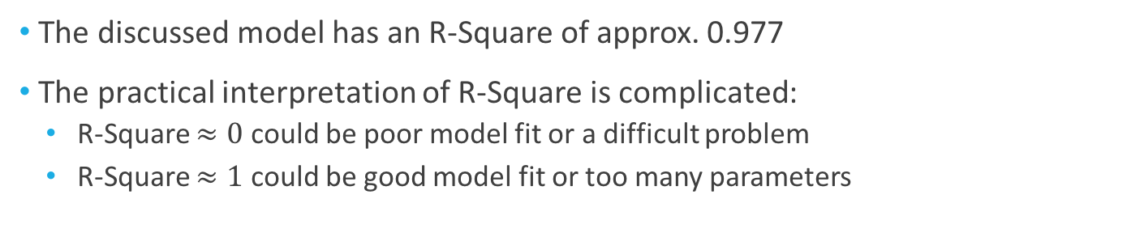
Correlation and R-Square
The discussed model has an R-Square of approx. 0.977
The practical interpretation of R-Square is complicated:
R-Square $≈0$ could be poor model fit or a difficult problem
R-Square $≈1$ could be good model fit or too many parameters

Slide 44
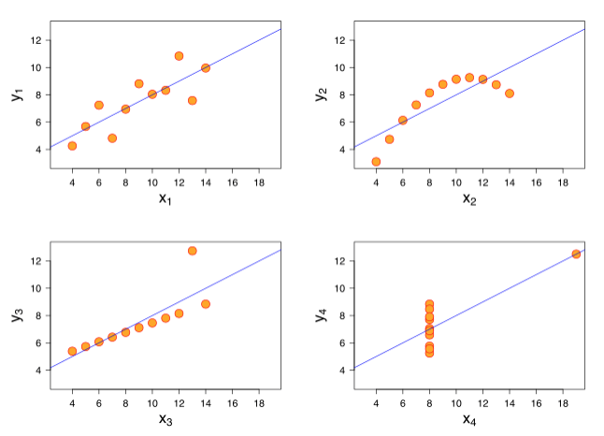

Correlation and R-Square
It is important to not read too much into it as a single indicator of model fit
(see Chapter 10.4.1)
All these have same $R^{2} ($from Wikipedia entry)

